Slide 1
„Mobilność kadry edukacji szkolnej”
International High Five for Teachers – together for innovation
Beata Janiak
Malta 31.07-11.08.2017

Slide 2
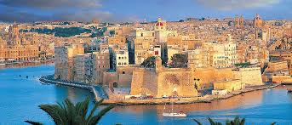
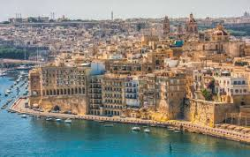
Malta – My learning and culture experience.

Slide 3
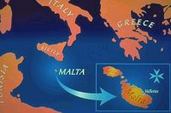
BRIEF HISTORY OF THE ISLANDS OF MALTA AND GOZO
Malta is situated in the middle of the Mediterranean Sea, halfway between Gibraltar and Alexandria, Sicily and North Africa. Thus it has always been at the cross-roads of the trading and warring routes. .
Location

Slide 4
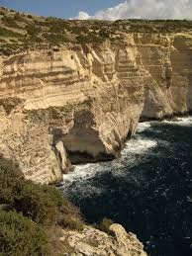
A brief history
4500 years BC, people from the neighbouring island of Sicily decided to cross the narrow waters to investigate.
They settled on the island and sheltered in many caves which exist there.

Slide 5
End of Sicilian decade
So the settlers started to cultivate the land and build their buildings.
They probably disappeared because of famine.

Slide 6
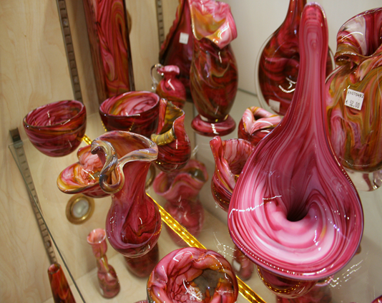
Name and language
'Malta' derives from the Phoenician word 'Maleth', meaning refuge.
The Maltese language comes from the Phoenician period (1200B.C.) The Phoenicians also introduced glass making and weaving and built temples were they could worship their gods.

Slide 7
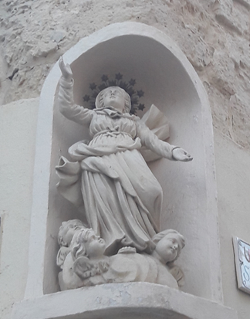
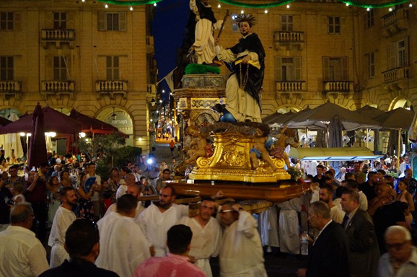
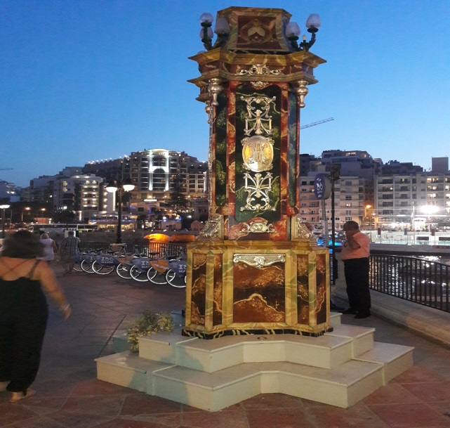
Christianity
In AD 58 St. Paul, who was on his way to Rome as a prisoner, was shipwrecked on the Island. He stayed there for three months during which time he introduced Christianity to the people.

Slide 8
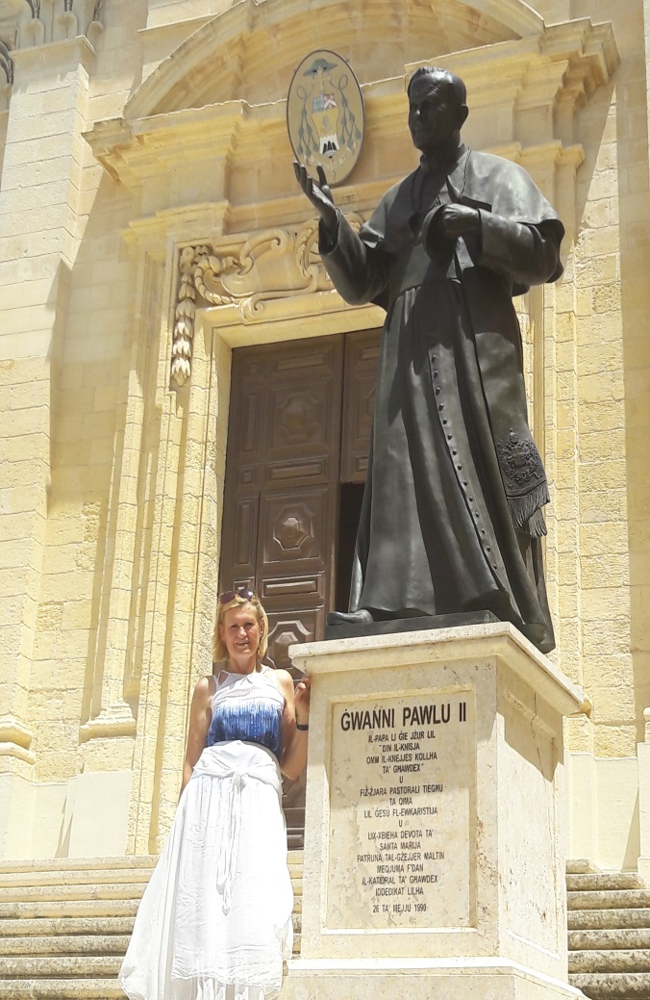

Slide 9
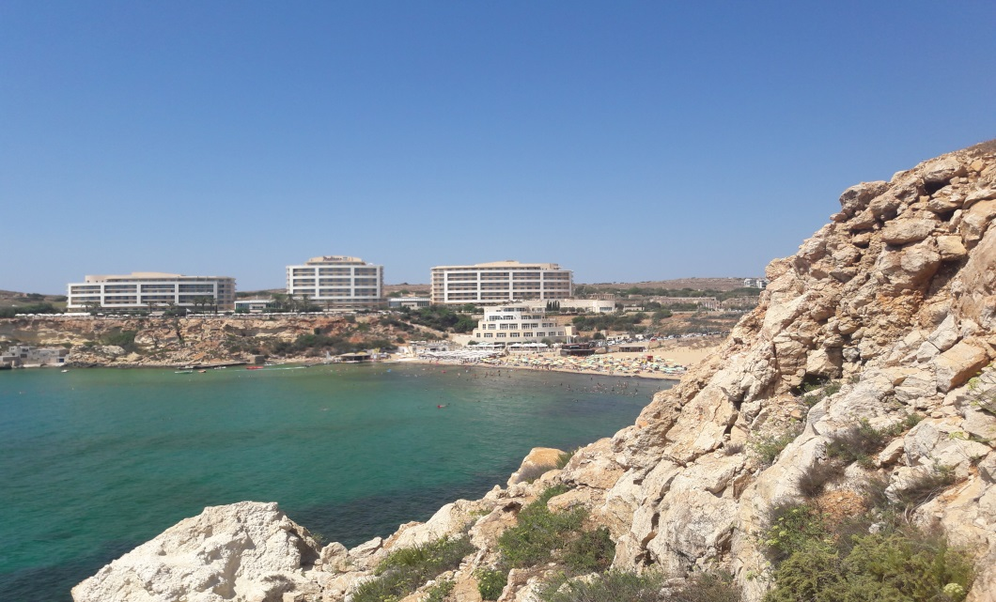
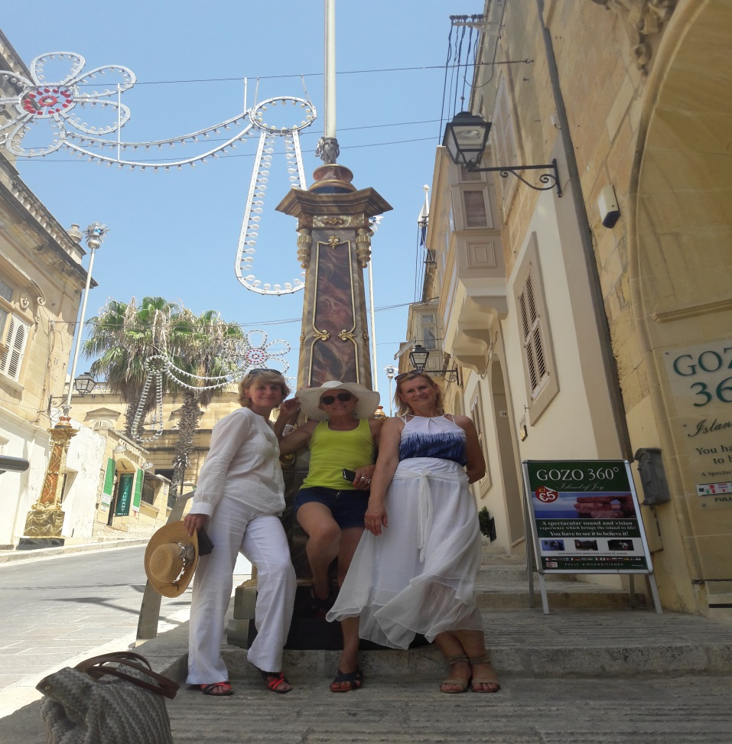
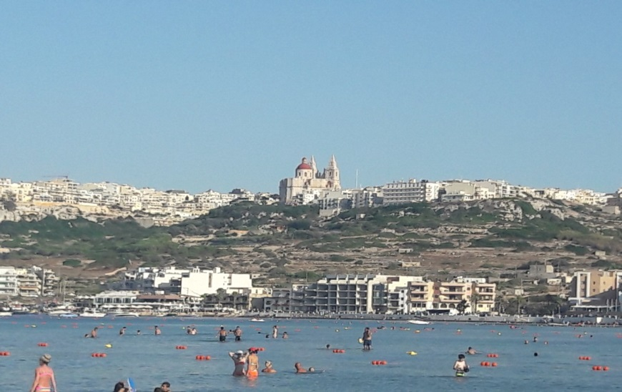
Visiting places
Due to beautiful landscapes and weather I could combine learning, sightseeing and relaxing .

Slide 10
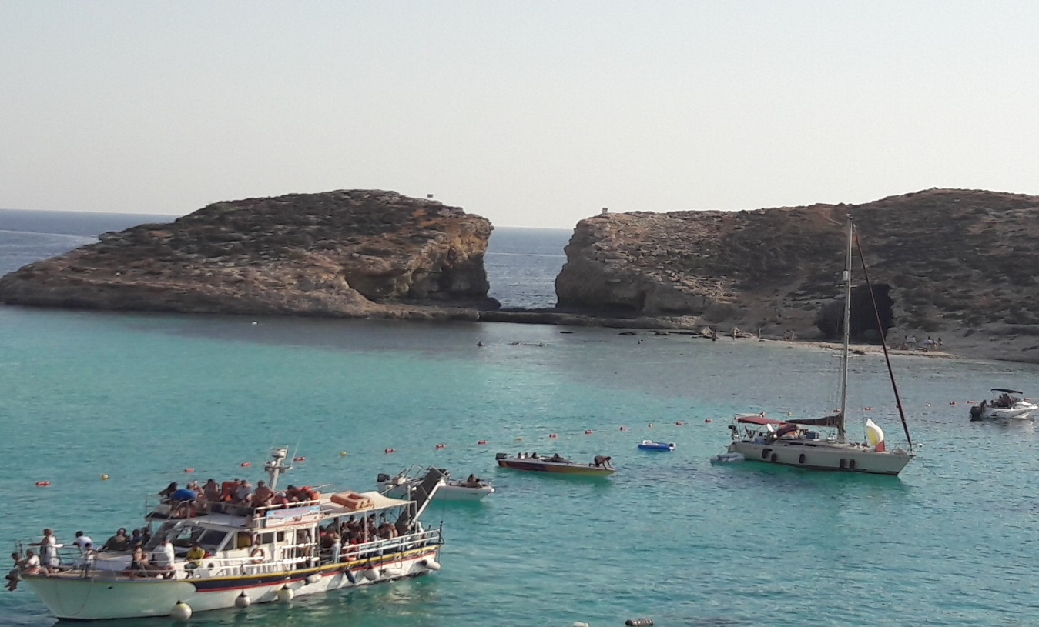

Slide 11
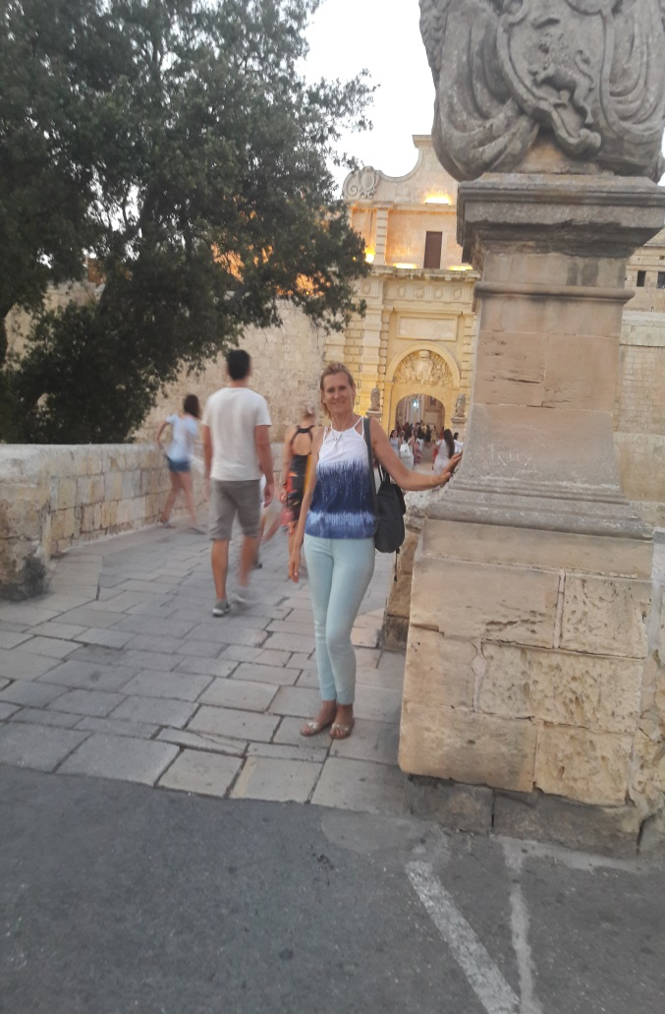
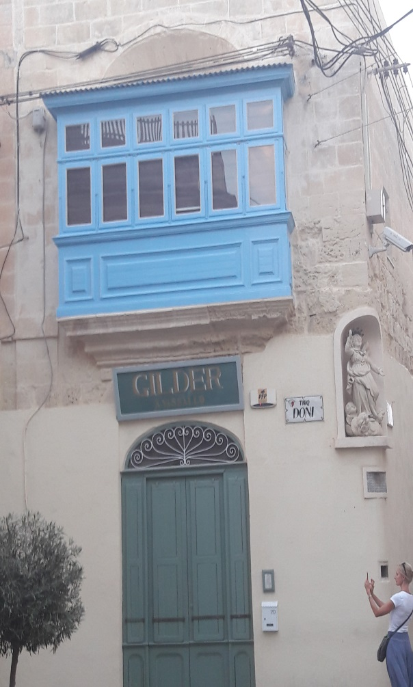
Islam on Malta
Islam started when Mohammed came to Medina in Malta in AD 622.
It resulted in Arab influence on Maltese architecture and language .

Slide 12
The Knights of St. John of Jerusalem ruled over Malta from 1530 to 1798 defended it and took it through a new golden age. Caravaggio, Preti and Favray were allowed by the Knights to embellish churches and palaces .

Slide 13
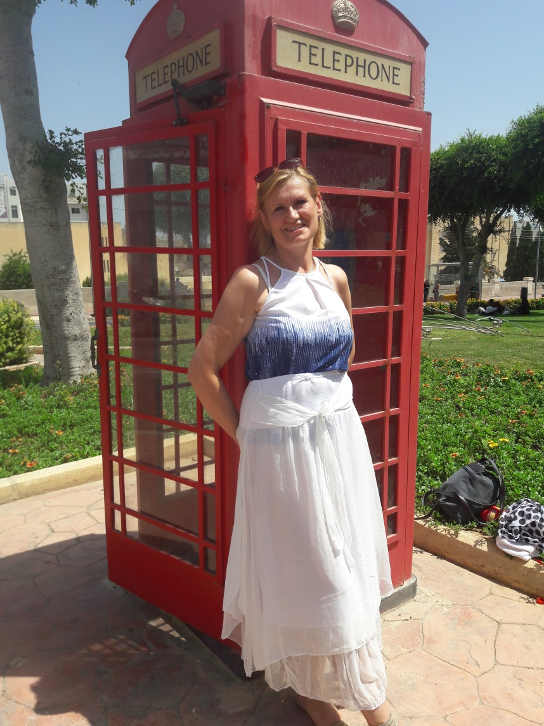
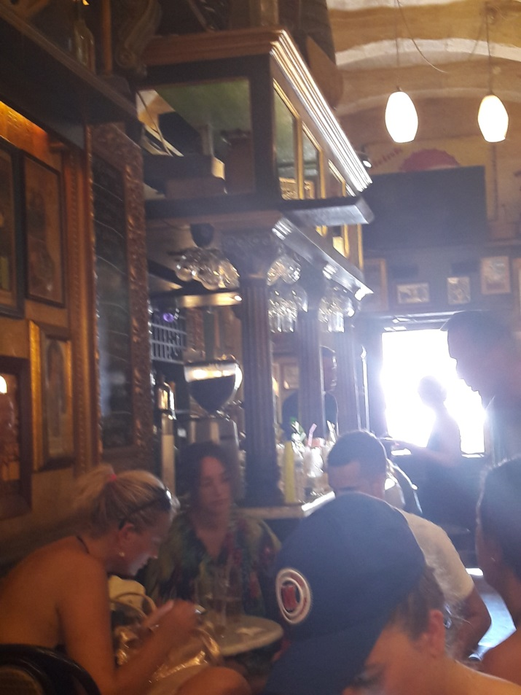
British people on Malta
It is time to talk about British rule on Malta which lasted until 1964 when Malta became independent but Maltese adapted English language, British system of administration, education and legislation. I could see the signs of British culture in many places in streets, pubs, at school.
Modern Malta became a Republic in 1974 and joined the European Union in May 2004.

Slide 14
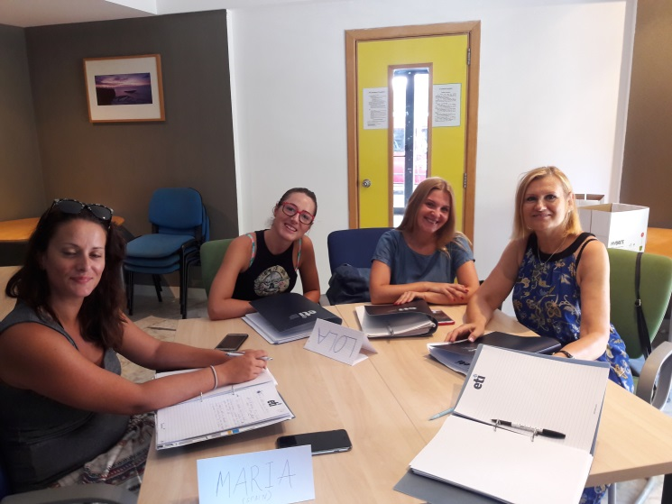
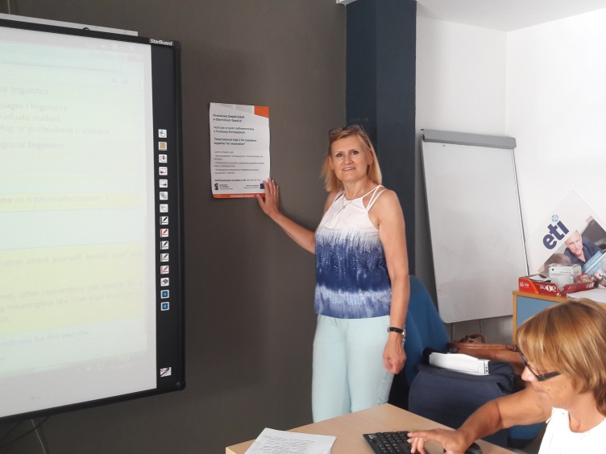
International classes in the well-equipped school

Slide 15
Exchanging teaching methods and looking for innovations

Slide 16
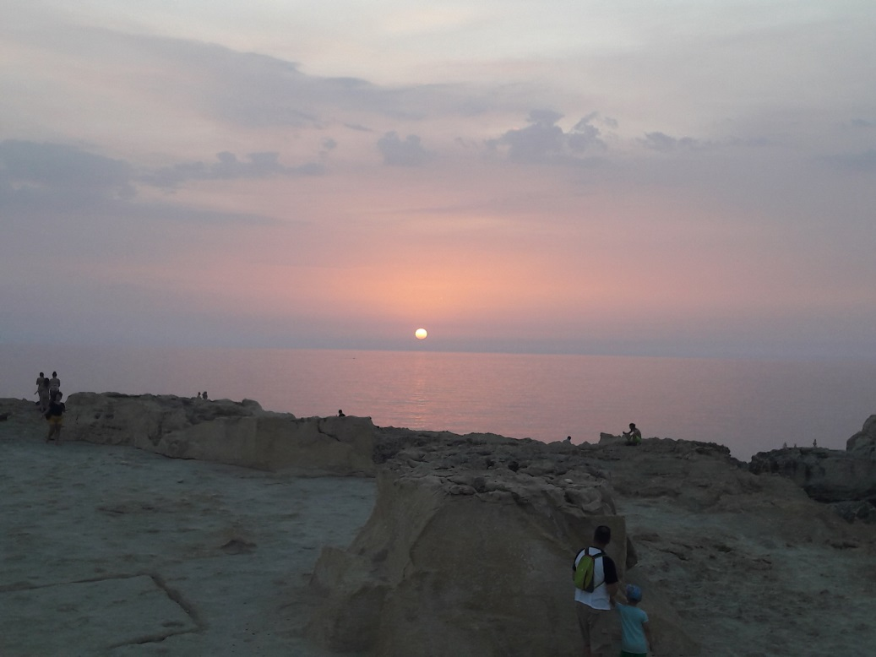
Thank you for your attention

